Slide 1
2025 ANNUAL REPORT
Harborview Medical Center
A DESIGNATED LEVEL I TRAUMA CENTER
Inpatient Rehabilitation Unit
Mission: The mission of the Department of Rehabilitation Medicine is to improve the health, function, and quality of life of those we serve.
Values: We strive to provide excellent care, enhanced by a strong commitment to teaching, community service, and research. It is our belief that the highest quality rehabilitation is best achieved in partnership with the patient and their family. Our staff respects diversity and recognizes that every person deserves their own unique treatment plan.

Slide 2
2025 Harborview
Inpatient Rehabilitation Unit
In 2025 the Department of Rehabilitation Medicine at Harborview Medical Center served a higher percentage of brain injury, spinal cord injury, amputation, and burn patients than other healthcare facilities in the region and nation. Stroke, brain injury, and spinal cord injury patients comprised 79% of our total patient population for the year.
Functional Outcome Measures are used to score a patient's independence include Self-Care and Mobility. The change in score from admission to discharge shows the patient's improvement in independent function.

Slide 3

Patient satisfaction outcomes
Harborview Inpatient Rehabilitation Patient Experience
Information was obtained from Medtel Patient Satisfaction Surveys given to all patients 3 months after discharge from the Harborview Rehabilitation unit.
Overall Satisfaction with the services received during rehabilitation stay:
96% reported overall satisfaction with stay
- 83% very satisfied
- 13% somewhat satisfied
Harborview EXCEEDS the national benchmarks with the following
Patient experiences measures:
Higher percentage of patients that reported that:
  they were satisfied with their rehabilitation stay
  they were involved with decision making during their rehabilitation stay
  the rehabilitation program prepared them for going home.
  the progress that they made in rehabilitation met their expectations
  the rehabilitation program improved their quality of life
Lower overall post-discharge hospitalizations

Slide 4
Patient stats
Stroke, Brain Injury, and Spinal Cord Injuries comprised 79% of our patient population for the year.
The average patient length of stay was 17.7 days.
The average HMC patient’s age was 53.5 ears old, compared to the national average of 64.2.
Male admissions totaled 66.5%, female admissions 33.5%
There were
6 adolescents
(≤18 yrs) treated during the year.

Slide 5
2025 Harborview
Inpatient Rehabilitation Unit
88% of patients are living at home 3 months post discharge. Patients continue to gain independence and improve their overall function to allow them to return to the community setting.
HARBORVIEW'S MISSION
Harborview Medical Center’s inpatient rehabilitation facility serves a uniquely diverse patient population, including many individuals with complex medical conditions and significant social needs. While our rate of discharge to the community is lower than some other rehabilitation facilities, this reflects our commitment to the Harborview mission—providing high-quality, comprehensive care to all, regardless of complexity. We are proud to serve as a critical safety net for our community, helping patients with the greatest challenges take meaningful steps toward recovery.

Slide 6
Award Funding 2025
UW Rehabilitation Medicine
Community Partnerships: Rhonda Weiss Center, UW Employment Program, NW ADA Center, ADA Participation Action Research Consortium, ADA National Network Knowledge Translation Center, and RRTC on Employment for People with Physical Disabilities.
VA: VHA AMPREDICT Decision Support Tool, Optimizing Ankle-Foot Orthotic Prescription, Patient Centered Prosthetic Foot Prescription and Rehabilitation Strategy, Soltani IPA, Superiority Trial of Radiofrequency Ablation for LBP, SCIM Fellowship Grant
Research: Burn Model Systems, DMD Epigenetic Mechanisms and Advancing Small Molecule Therapies, Roles of FXR1 in Health and Myopathy, Cross-Species Preclinical Platform to Enhance Translation of New Medicine, Genetic Medicine Approaches to Treat Orphan Diseases, OStim to Treat SCI
Physical Therapy: Mobile Health Exercises for IPF, New Oximeter for Exercise, Ableism and Health, Gait Training in Infants with Down Syndrome, Sitting and Reaching for Young Children with Cerebral Palsy, LEARRN LHS, Older Adults with CLBP and MCC, Acute tSCS for Autonomic Recovery, Closed-Loop tSCS
Occupational Therapy: Early Intervention for PAE for FAS, Efficacy of IPASS-R, Impacts of Post-Acute Payment, ADRD Disparities in Home Health
Speech & Language: Communicative PRO and Stress, Reducing Social Isolation for Adults, Listener Training for People with Parkinson’s, Biopsychosocial Approach in Adolescents with Down Syndrome
Rehab Psych: Cognitive Function in MS, SCI Cognitive Screen, BeHEALTHY Program, Improving CPS in SCI, Motivational Interviewing in SCI Rehab, TBI Model Systems, Exercise for MDD in MS, MS Needs for Tech MBTC, TBI SEQUELAE FOR AD, Treatment of Pain after TBI, Neurodegeneration in TBI, Leveraging TBIMS for Late Effects TBI, ENRICH Brain Health Study, On-TRACC, Spinal Cord Injury Model Systems, I-HEAL for Veterans and Service Members with TBI, Mobility and Ableism after SCI, MOD Study, Music4Pain Network, MM and HYP Lab Study, LGS Caregiver Study, Outcomes after mTBI, M&M Study, Post-TBI Sleep Disruption, GPE for Rehab Psych, Telehealth Intervention for Fatigue in Adults with MS, ARRT Policy, ACT for Healthcare
Prosthetics & Orthotics: Myoelectric Orthosis, Uneven Surface Training, WALKCP, Hip Muscle Co-Contraction, Prothesis Awareness, Myoelectric Control in people with Transradial Amputation, Grief Measurement after Amputation, Bionic Prosthesis
Other: IPR after Firearm-Related Injury, Long Covid Clinic, Rehab Medicine Scientist Training Program, Essential Tremor Study, SARS-CoV-2 Infection and Risk of Cognitive Decline.

Slide 7
Model Systems 2011-2025
Harborview Inpatient Rehabilitation Unit
Northwest Regional Spinal Cord Injury System
The University of Washington TBI Model System
The Northwest Regional Spinal Cord Injury System (NWRSCIS) is centered within the Department of Rehabilitation Medicine at University of Washington Medical Center and Harborview Medical Center.
The mission of the NWRSCIS is to improve the lives of people with SCI through excellent patient care, research and education. We are continuing to follow individuals enrolled in the SCI Model System funded by the National Institute on Disability, Independent Living, and Rehabilitation Research (NIDILRR). We disseminate the most useful, evidence-based information to people with SCI, their families, and professionals through our education forum presentations, written materials and videos posted on our website: sci.washington.edu and on our YouTube channel: https://www.youtube.com/user/UWSpinalCordInjury. Faculty have continued to publish scientific studies from data obtained through NIDILRR-funded research.
The University of Washington Traumatic Brain Injury Model System (TBIMS) successfully competed to be one of 16 centers funded by the National Institute on Disability, Independent Living, and Rehabilitation Research (NIDRR) for 2017-2022 (Grant 90DPTB008).
Our goal is to promote the health, well being, and recovery of persons with TBI by applying knowledge from cutting edge research into our clinical care. UWTBIMS research areas include treatment of chronic pain after TBI, learning about physical activity in the first year after TBI, gaining knowledge on return to driving, and learning more about cognitive function over time following a TBI. We are also partnering with other funding partners to improve the transition from inpatient rehabilitation to the community and assessing sleep apnea after TBI. We continue to provide educational opportunities to the community in partnership with BIAWA by providing expert speakers on a variety of topics. Newsletters and educational materials are also available on our website. We are currently working on developing graphic educational tools on topics in TBI. More information on our TBIMS investigators, projects, and educational materials can be found at www.tbi.washington.edu.

Slide 8
Panels, Groups, and Activities
The University of Washington and Harborview Medical Center sponsor ongoing events to educate and assist former patients as well as the general public. Examples include:
  Spinal Cord Injury Forum
  Amputee Support Group
  Brain Injury Information and Support Group
  Stroke and Head Injury Caregiver Support Group
  Young Adults with TBI Support Group
The Assistive Technology Board celebrated its third anniversary this year. The board is comprised of patients, families, clinicians and industry leaders with a focus on facilitating education, resource allocation, development, and collaboration related to assistive technology needs in spinal cord injury rehabilitation.
The SCI Peer Program strives to match newly injured patients, who are interested, to a person in the community who has successfully adjusted to living with an SCI. Our peers have had similar life experiences and this provides an opportunity for the exchange of information, support, encouragement, and presenting a positive role model.
The Spinal Cord Injury Forum is an educational program for persons with SCI and their friends, family members, caregivers, and health providers, held at the UW Medical Center. The forum provides current information on a variety of topics relevant to the SCI community, such as maintaining good nutrition, bladder management, assistive technology, fertility after SCI, recreational activities, and recovery research. Northwest Regional Spinal Cord Injury System (washington.edu)

Slide 9
Panels, Groups, and Activities
(continued)
The Amputee Support Group is held every Tuesday from 11:00-12:30 at 4 West Hospital, Room 73 (except holidays). The group offers a place for amputees and their family members to connect with others who have faced similar challenges. This is a fantastic place to get information and/or support and is open to the community. Harborview Amputee Support Group (uw.edu)
Brain Injury Information and Support Group is held once a week to provide support for families and friends of current HMC patients (critical care/acute/inpatient/outpatient). This group is facilitated by Harborview staff and others who have experienced brain injuries to not only answer questions, but also to provide supportive listening and additional resources. Homepage Articles - The Weekly Harborview Brain Injury Support... (uwmedicine.org)
The HMC Stroke Support Group is a free resource available to stroke survivors and family members seeking additional support. To help lay the foundation for recovery and transition into a life after stroke, members of the HMC Stroke Team will be available to answer questions and review education topics such as risk factors, social resources, medication management, and life after discharge. This group meets every 4th Tuesday from 10:00 am–11:00 am at NJB 671 (HMC).
The Inpatient Rehab Patient and Family Advisory Panel is held biannually. Former patients and family members are invited to attend and provide feedback on their rehabilitation stay. Offering suggestions on how our rehabilitation team can improve, what strengths we should continue to foster and how the environment impacted their stay.

Slide 10
2025 Publications
Addoh O, Axelrod A, Gormley C, Mahasin S, Tonkin B, Senk A, Seidel E. Use of Videos as Disability Educational Tools for Medical Students. International Medical Education, 2025 Oct 15:4(4). DOI: 10.3390/ime4040041.
Babitts A, Chen AT, Fillipo R, Friedly JL, Jarvik JG, Suri P, Rundell SD. Comparing Influential Variables for Low and High Recovery Expectations among Those with Lumbar Spinal Stenosis: A Network Analysis. Journal of Pain, 2025 Apr:29(1). DOI: 10.1016/j.jpain.2025.105130.
Barnett HM, Seeds AN, Dowell KR, Nehra D, Crane DA. Timing of surgical intervention after firearm-related spinal cord injury. J Spinal Cord Med, 2025 Sep 3:48(5):912-919. DOI: 10.1080/10790268.2024.2379069.
Friedly JL, Roman J, Long J, Grewal M, Chopra A, Bender J, Gentile N, Knowles LM, Herring T, O'Loughlin K, Rivera N. The healing role of music and arts in long COVID: A patient perspective. PM&R, 2025 Jun:17(6):709-715. DOI: 10.1002/pmrj.13430.
Gold LS, Heagerty PJ, Hansen RN, Friedly JL, Deyo RA, Curatolo M, Turner JA, Rundell SD, Jarvik JG, Suri P. Adverse respiratory events during treatment with gabapentin and opioids among older adults with spine-related conditions: A propensity-matched cohort study in the US Medicare population. Spine Journal, 2025 Sep:25(9):2096-2107. DOI: 10.1016/j.spinee.2025.03.014.
Gold LS, Heagerty PJ, Hansen RN, Friedly JL, Johnston SK, Deyo RA, Curatolo M, Turner JA, Rundell SD, Wysham K, Jarvik JG, Suri P. Mortality after concurrent treatment with gabapentin and opioids in older adults with spine diagnoses. Pain, 2025 Apr:166(4):e51-e59. DOI: 10.1097/j.pain.0000000000003448.
Haarbauer-Krupa J, Wallace T, Clause D, Draganich C, Seeds A. Understanding The Healthcare Needs of Uninsured Individuals With Brain Injuries In The United States. Brain Injury, 2025 Aug 1:39(S1):S113-S114.
Hicks CD, Barnett HM, Shi JNF, Velonjara J, Kmail Z, Vavilala MS, Lindo EG. Let's not steal equity from our patients in the name of quality. Frontiers in Public Health, 2025 Jun 6:13. DOI: 10.3389/fpubh.2025.1522743.
Lanahan CL, Allyn KJ, Coburn KA, Mertens JC, Krout AJ, DeGrasse NS, Larsen BG, Hafner BJ, Friedly JL, Sanders JE. Frequent versus infrequent partial doffing in transtibial prosthesis users as a means to stabilize residual limb fluid volume. Clinical Biomechanics, 2025 Jun:126. DOI: 10.1016/j.clinbiomech.2025.106537.
Morgan SJ, Friedly JL, Nelson IK, Rosen RE, Humbert AT, Hafner BJ. The effects of microprocessor prosthetic knee use in early rehabilitation: A pilot randomized controlled trial. PM&R, 2025 Apr:17(4):371-383. DOI: 10.1002/pmrj.13321.
Ott J, Bettger JP, Kim H, Oh-Park M. Application of Systematic Assessment of Rehabilitation Situation (STARS) Framework for Stroke Rehabilitation in the United States of America. Current Physical Medicine and Rehabilitation Reports, 2025 Mar 11:13(1). DOI: 10.1007/s40141-025-00482-w.
Roseen EJ, Welch SA, Stout N, Bean JF, Friedly JL, Mittman BS. An introduction to implementation science in rehabilitation medicine. PM&R, 2025 Nov:17:S6-S20. DOI: 10.1002/pmrj.70040.
Rundell SD, Meier EN, Jarvik JG, Friedly JL, Horn ME, Suri P, Cizik AM, Heagerty PJ, Johnston SK, Fillipo R, Burke C, Danyluk ST, Seebeck K, Goode AP. Phenotypes of patients with symptomatic lumbar spinal stenosis presenting for nonoperative care: baseline data from the Lumbar Stenosis Prognostic Subgroups for Personalizing Care and Treatment Study (PROSPECTS). Pain Medicine, 2025 Aug:27(2):177-188. DOI: 10.1093/pm/pnaf099.

Slide 11
2025 Publications (continued)
Sajdeya R, Yanez ND, Kampp M, Goodman MD, Zonies D, Togioka B, Nunn A, Winfield RD, Martin ND, Kohli A, Huynh TT, Okonkwo DO, Poblete RA, Gilmore EJ, Chesnut RM, Bunnell AE, Ohnuma T, Hashemaghaie M, Treggiari MM. Early Blood Pressure Targets in Acute Spinal Cord Injury: A Randomized Clinical Trial. JAMA Network Open, 2025 Sep 18:8(9). DOI: 10.1001/jamanetworkopen.2025.25364.
Smith NL, James A, Matin N, Fong CT, Sharma M, Lele AV, Robba C, Mazwi N, Wiseman DB, Bonow RH, Kross EK, Creutzfeldt CJ, Town J, Wahlster S. Long-Term Outcomes After Severe Acute Brain Injury Requiring Mechanical Ventilation: Recovery Trajectories Among Patients and Mental Health Symptoms of Their Surrogate Decision Makers. Neurocritical Care, 2025 Jun:42(3):896-910. DOI: 10.1007/s12028-024-02164-2.
Stovall R, Blat C, Roberts E, Liew J, Wysham K, Singh N, Friedly J, Gensler LS, Schmajuk G, Yazdany J. Sex differences in medication discontinuation in axial spondyloarthritis. Arthritis & Rheumatology, 2025 Oct:77(9):5097-5099.
Suri P, Timmons AKI, Korpak AM, Tanus AD, Brubeck HF, Daniels CJ, Scott H, Morelli D, Costa N, Hodges PW, Day MA, Friedly JL, Heagerty PJ, Jensen MP. Transient and Long-Term Risks of Common Physical Activities in People With Low Back Pain. JAMA Network Open, 2025 Dec 9:8(12). DOI: 10.1001/jamanetworkopen.2025.47915.
Tanus AD, Nishio I, Williams R, Friedly J, Soares B, Anderson D, Bambara J, Dawson T, Hsu A, Kim PY, Krashin D, Del Piero L, Korpak A, Timmons A, Suri P. Combining procedural and behavioral treatments for chronic low back pain: A pilot feasibility randomized controlled trial. PM&R, 2025 Apr:17(4):431-444. DOI: 10.1002/pmrj.13323.
Vamos AC, Youngblood RT, Lanahan CL, Allyn KJ, Friedly JL, Sanders JE. Using Bioimpedance Analysis as a Clinical Predictive Tool for the Assessment of Limb Fluid Volume Fluctuation: An Initial Investigation of Transtibial Prosthesis Users. Prosthesis, 2025 May 16:7(3). DOI: 10.3390/prosthesis7030053.
Zaim SR, Castillo JD, Cabrera A, Sankary K, Ramirez G, Li XJ, Morales LS. Long COVID among Latino Patients of Two Federally Qualified Health Centers in Washington State. Journal of General Internal Medicine, 2025 Aug:41(4):983-985. DOI: 10.1007/s11606-025-09732-y.

Slide 12
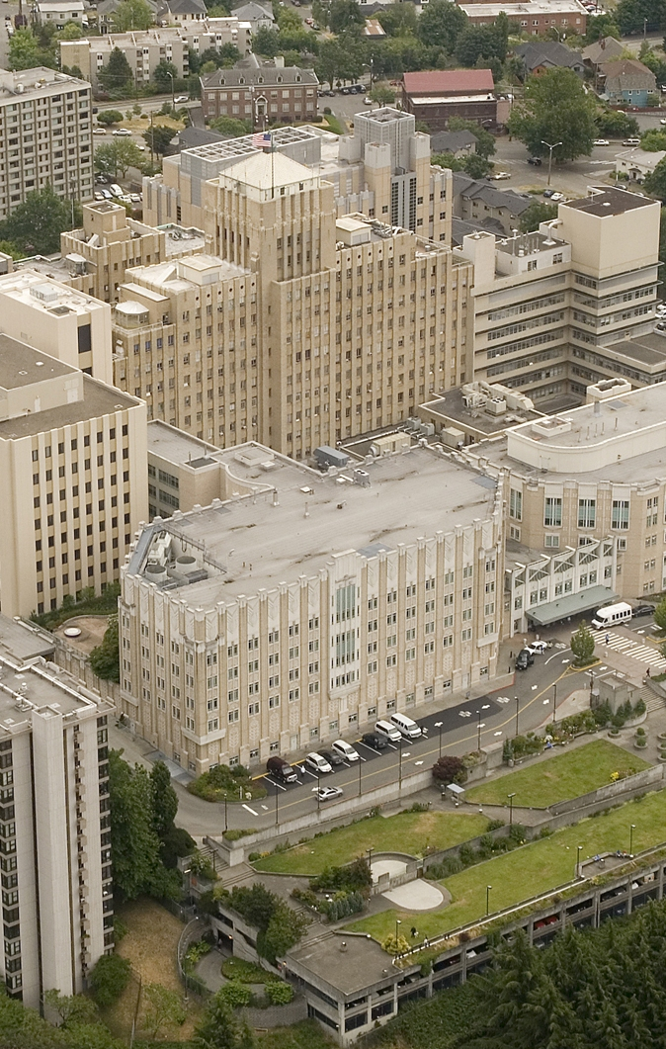
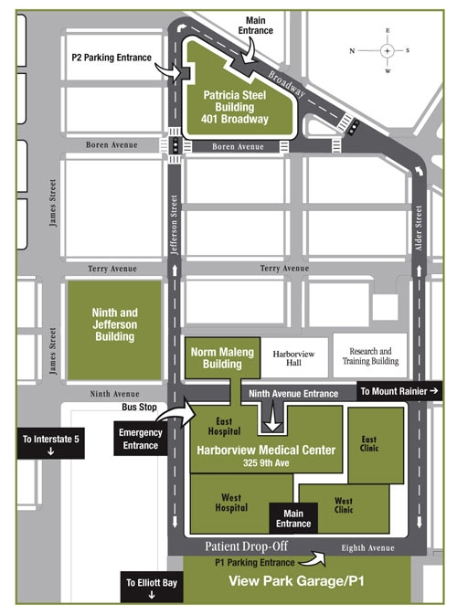

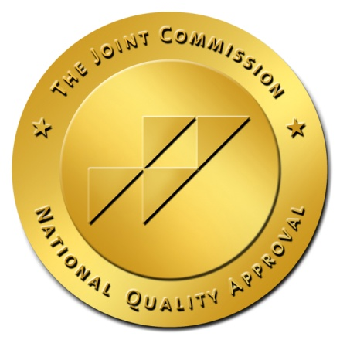
Harborview Medical Center
Inpatient Trauma Rehabilitation
325 9th Avenue, Box 359818
Seattle, Washington 98104
4 West Front Desk 206.744.3201
Nurse Manager 206.744.4447
Therapy Manager 206.744.2824
Inpatient Admissions
Coordinator 206.744.4607

